Slide 1
Q-Section Error Correcting Codes for PAPR Reduction
Speaker : Te-Sheng Fan
Advisor : Prof. Mao-Chao Lin
Date : 2020.07.16

Slide 2
Outline
Introduction of PAPR Issue
Some Reduction Techniques
System Model
Q-section Error Correcting Codes
Non-Coherent Block Coding (NBC)
Example of Polar-Coded Partial Transmit Sequence (PTS) Scheme for PAPR Reduction
Q-Section LDPC Codes Design
Encoding/Decoding Procedure
Protograph-Based LDPC
The Proposed Q-section PEG (Q-PEG)

Slide 3
Non-Binary LDPC Codes
Some Basics
Bit-Flipping Method for PAPR Reduction
Side Information Embedded Selective Mapping (SLM) for PAPR Reduction
Conclusions and Future Work

Slide 4
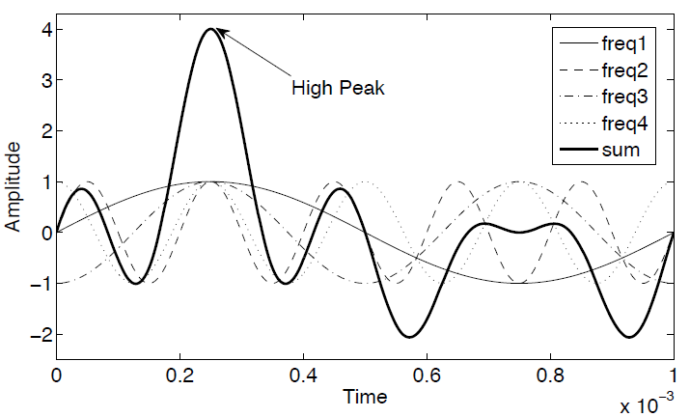

Peak-to-Average Power Ratio (PAPR)
In single-carrier systems, the transmitted signal only depends on one data symbol, hence its power vary in a small range. However, the transmitted signal of multi-carrier system such as OFDM is the summation of all the subcarriers, result in high PAPR of transmitted signal.
For the discrete-time OFDM signal, PAPR is expressed as $PAPR=\frac{\max_{0≤n≤N−1}{{\left|x\left[n\right]\right|}^{2}}}{E[{\left|x\left[n\right]\right|}^{2}]}$ where $E[∙]$ is the expectation operator.
When the independently modulated subcarriers are added coherently, the instantaneous power will be more than the average power
$$(1)$$
[1] Rahmatallah, Y., Mohan, S.: ‘Peak-to-average power ratio reduction in OFDM systems: a survey and taxonomy’, IEEE Commun. Surv. Tutor., 2013, 15, (4), pp. 1567–1592

Slide 5
Such a high PAPR demands high dynamic range in power amplifier (PA). If not biased properly, the PA easily enters into saturation, causing nonlinear amplification of signal (spectral growth of intermodulation among subcarriers and out-of-band radiation). To accommodate this issue, the PA must work at an operating point $P_{i,avg}$, i.e., a large input back-off (IBO) caused inefficient power conversion.
To ensure that the amplified peaks of the OFDM signal do not exceed the saturation level, IBO should be at least equal to PAPR.
Output power(dB)
Ideal Operation Point
Linear Region
$$P_{o,avg}$$
$$P_{o,sat}$$
Actual Operation Point
Saturation Region
IBO
Input power(dB)
$$P_{i,avg}$$
$$P_{i,sat}$$

Slide 6
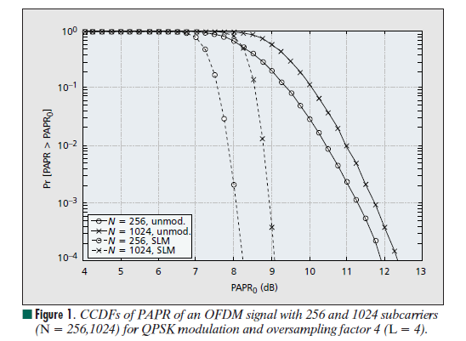
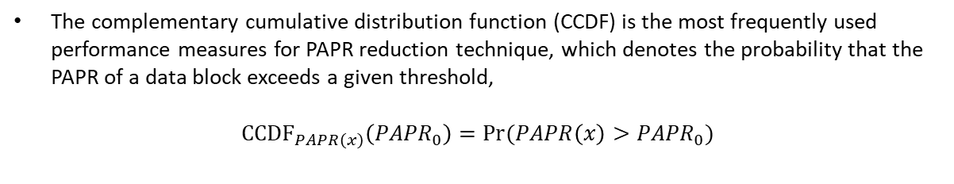

CCDF of the PAPR
The complementary cumulative distribution function (CCDF) is the most frequently used performance measures for PAPR reduction technique, which denotes the probability that the PAPR of a data block exceeds a given threshold,
$${CCDF}_{PAPR\left(x\right)}\left({PAPR}_{0}\right)=Pr⁡(PAPR\left(x\right)>{PAPR}_{0})$$
$$(2)$$
[2] S.H. Han and J.H. Lee, “An overview of peak-to-average power ratio reduction techniques for multicarrier transmission,” IEEE Wireless Comm., vol. 12, pp. 56–65, Apr. 2005.

Slide 7
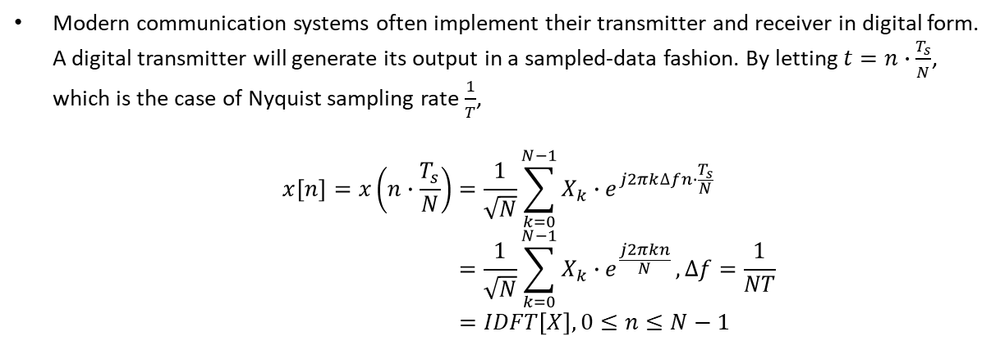

Discrete-Time OFDM Signal
Modern communication systems often implement their transmitter and receiver in digital form. A digital transmitter will generate its output in a sampled-data fashion. By letting $t=n∙\frac{T_{s}}{N}$, which is the case of Nyquist sampling rate $\frac{1}{T}$,
$$x\left[n\right]=x\left(n∙\frac{T_{s}}{N}\right)=\frac{1}{\sqrt{N}}\sum_{k=0}^{N−1}{X_{k}∙e^{j2πk∆fn∙\frac{T_{s}}{N}}} \\ =\frac{1}{\sqrt{N}}\sum_{k=0}^{N−1}{X_{k}∙e^{\frac{j2πkn}{N}}},∆f=\frac{1}{NT} \\ =IDFT\left[X\right], 0≤n≤N−1$$
$$(3)$$

Slide 8
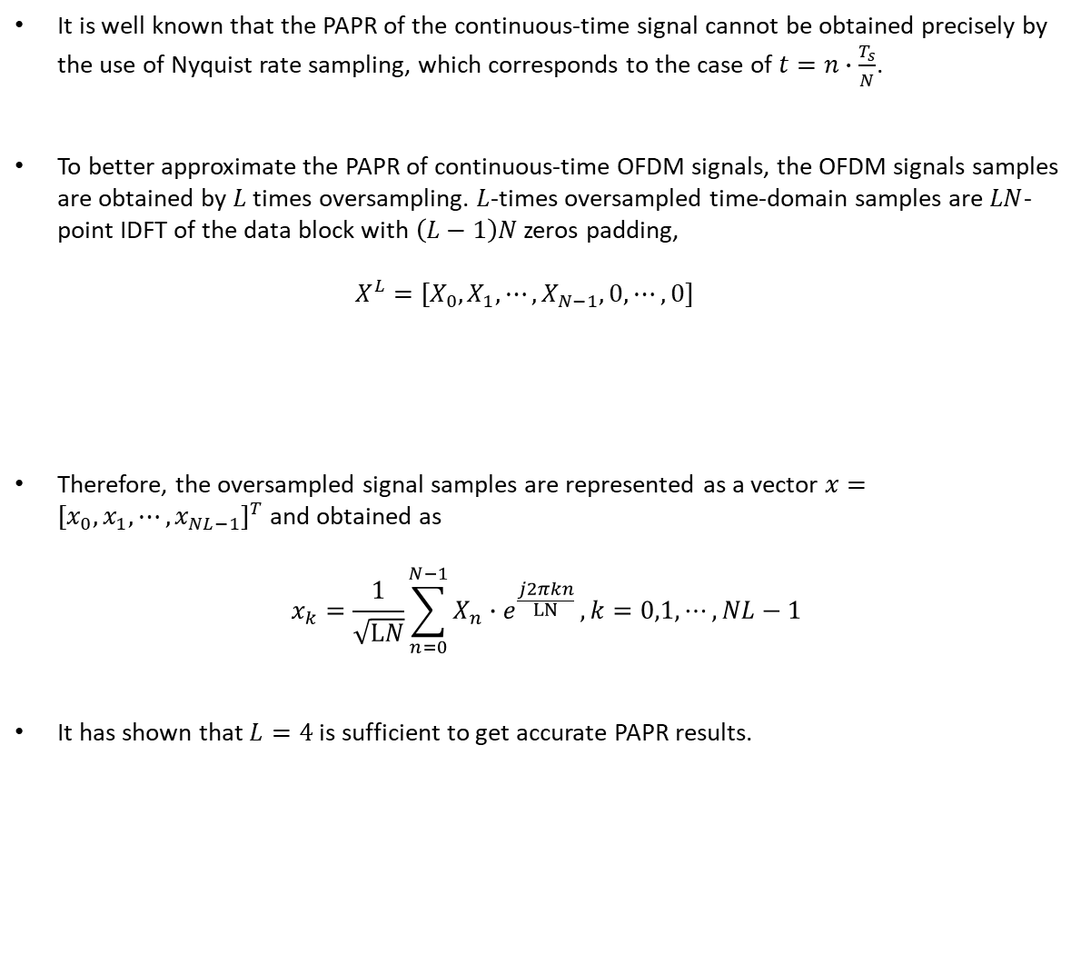

It is well known that the PAPR of the continuous-time signal cannot be obtained precisely by the use of Nyquist rate sampling, which corresponds to the case of $t=n∙\frac{T_{s}}{N}$.
To better approximate the PAPR of continuous-time OFDM signals, the OFDM signals samples are obtained by $L$ times oversampling. $L$-times oversampled time-domain samples are $LN$-point IDFT of the data block with $\left(L−1\right)N$ zeros padding, $X^{L}=[X_{0},X_{1},⋯,X_{N−1},0,⋯,0]$
Therefore, the oversampled signal samples are represented as a vector $x={[x_{0},x_{1},⋯,x_{NL−1}]}^{T}$ and obtained as
$$x_{k}=\frac{1}{\sqrt{LN}}\sum_{n=0}^{N−1}{X_{n}∙e^{\frac{j2πkn}{LN}}}, k=0,1,⋯,NL−1$$
It has shown that $L=4$ is sufficient to get accurate PAPR results.
$\left(L−1\right)N$ zeros
$$(4)$$

Slide 9
PAPR Reduction Techniques
There are many factors that should be considered before a specific PAPR reduction technique is chosen. These factors include PAPR reduction capability, power increase in transmit signal, BER increase at the receiver, loss in data rate, computational complexity increase, and so on.
Next, we briefly present some of the important PAPR reduction techniques with some examples.
PAPR Reduction Techniques
Signal Distortion
Multiple Signaling & Probabilistic
Coding
Clipping & Filtering
SLM
Linear Block Coding
PTS
ACE
[3] Jiang, T., and Wu, Y.Y.: ‘An overview: peak-to-average power ratio reduction techniques for OFDM signals’, IEEE Trans. Broadcast., 2008, 54, (3), pp. 257–268

Slide 10
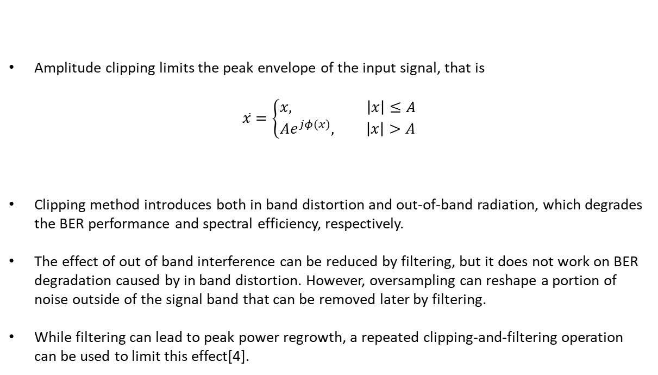

Amplitude Clipping and Filtering
Amplitude clipping limits the peak envelope of the input signal, that is
$$\overline{x}=\left\{\begin{aligned}x, \left|x\right|≤A \\ Ae^{jφ(x)}, \left|x\right|>A\end{aligned}\right.$$
Clipping method introduces both in band distortion and out-of-band radiation, which degrades the BER performance and spectral efficiency, respectively.
The effect of out of band interference can be reduced by filtering, but it does not work on BER degradation caused by in band distortion. However, oversampling can reshape a portion of noise outside of the signal band that can be removed later by filtering.
While filtering can lead to peak power regrowth, a repeated clipping-and-filtering operation can be used to limit this effect[4].
$$(5)$$
where $φ\left(x\right)$ is the phase of $x$.
[4] S. K. Deng and M. C. Lin, “Recursive clipping and filtering with bounded distortion for PAPR reduction,” IEEE Trans. Commun., vol. 55, no. 1, pp. 227–230, January 2007.

Slide 11
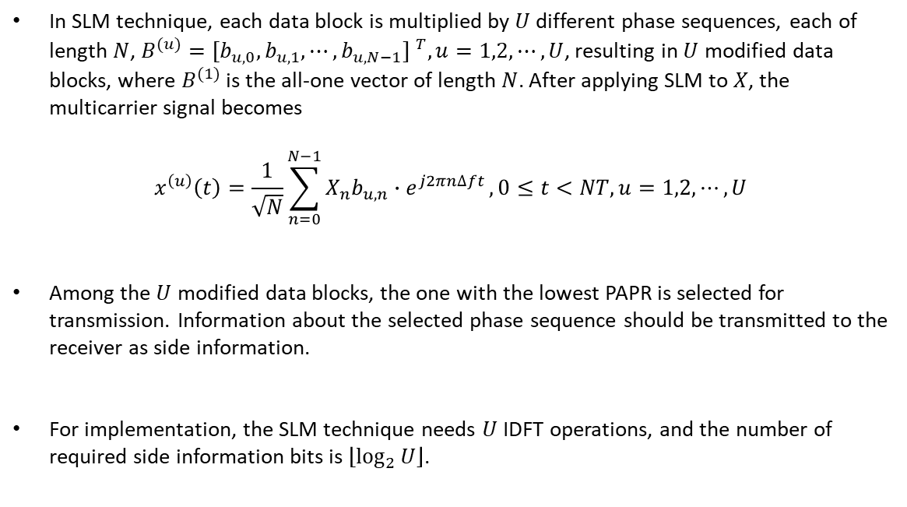

Selected Mapping (SLM)
In SLM technique, each data block is multiplied by $U$ different phase sequences, each of length $N$, $B^{(u)}={[b_{u,0},b_{u,1},⋯,b_{u,N−1}] }^{T}, u=1,2,⋯,U$, resulting in $U$ modified data blocks, where $B^{(1)}$ is the all-one vector of length $N$. After applying SLM to $X$, the multicarrier signal becomes
$$x^{\left(u\right)}\left(t\right)=\frac{1}{\sqrt{N}}\sum_{n=0}^{N−1}{X_{n}b_{u,n}∙e^{j2πn∆ft}},0≤t<NT, u=1,2,⋯,U$$
Among the $U$ modified data blocks, the one with the lowest PAPR is selected for transmission. Information about the selected phase sequence should be transmitted to the receiver as side information.
For implementation, the SLM technique needs $U$ IDFT operations, and the number of required side information bits is $\left\lfloor \log_{2}{U}\right\rfloor$.
$$(6)$$
[5] H. Breiling, S. H. Müller–Weinfurtner, and J. B. Huber, “SLM Peak-Power Reduction without Explicit Side Information,” IEEE Commun. Lett., vol. 5, no. 6, June 2001, pp. 239–41.

Slide 12
Selected Mapping (SLM)
$$B^{(1)}$$
Partition into blocks and serial to parallel conversion
$$⊗$$
$$X^{(1)}$$
IDFT
$$x^{(1)}$$
Select one with minimum PAPR
$$B^{(2)}$$
Data
Source
$$X$$
$$⊗$$
$$X^{(2)}$$
IDFT
$$x^{(2)}$$
$$x$$
$$⋮$$
$$⋮$$
$$B^{(U)}$$
$$X^{(U)}$$
IDFT
$$x^{(U)}$$
$$⊗$$

Slide 13
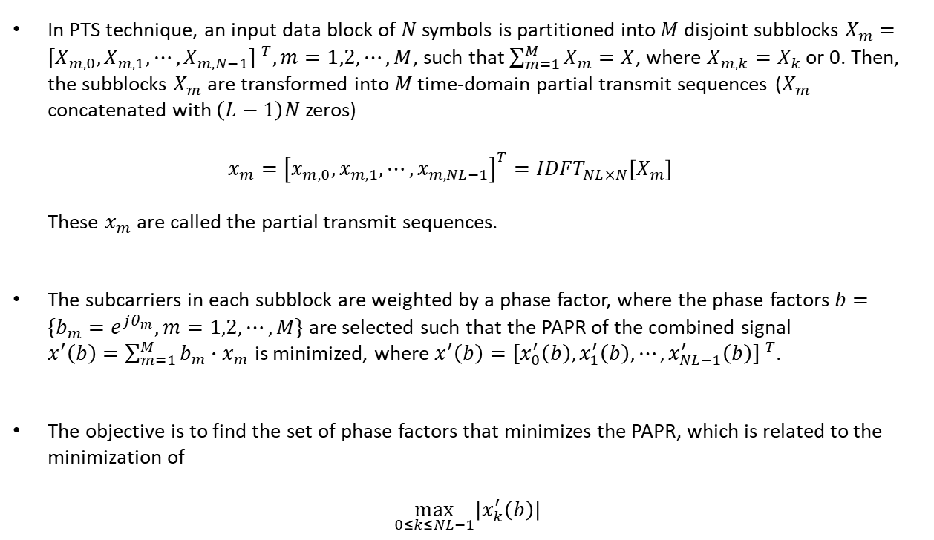

Partial Transmit Sequence (PTS)
In PTS technique, an input data block of $N$ symbols is partitioned into $M$ disjoint subblocks $X_{m}={[X_{m,0},X_{m,1},⋯,X_{m,N−1}] }^{T},m=1,2,⋯,M$, such that $\sum_{m=1}^{M}{X_{m}=X}$, where $X_{m,k}=X_{k}$ or 0. Then, the subblocks $X_{m}$ are transformed into $M$ time-domain partial transmit sequences ($X_{m}$ concatenated with $\left(L−1\right)N$ zeros) $x_{m}={\left[x_{m,0},x_{m,1},⋯,x_{m,NL−1}\right]}^{T}={IDFT}_{NL×N}\left[X_{m}\right]$ These $x_{m}$ are called the partial transmit sequences.
The subcarriers in each subblock are weighted by a phase factor, where the phase factors $b=\{b_{m}=e^{jθ_{m}},m=1,2,⋯,M\}$ are selected such that the PAPR of the combined signal $x^{′}\left(b\right)=\sum_{m=1}^{M}{b_{m}∙x_{m}}$ is minimized, where $x^{′}\left(b\right)={[x_{0}^{′}\left(b\right),x_{1}^{′}\left(b\right),⋯,x_{NL−1}^{′}\left(b\right)] }^{T}$.
The objective is to find the set of phase factors that minimizes the PAPR, which is related to the minimization of
$$\max_{0≤k≤NL−1}\left|x_{k}^{′}\left(b\right)\right|$$
$$(7)$$
[6] X.Li and L.J.Cimini, ”Effect of clipping and filtering on the performance of OFDM,” IEEE Commun. Lett., vol.2, no.5, pp.131-133, May 1998.

Slide 14
Partial Transmit Sequence (PTS)
$$X_{1}$$
$$∙$$
$$b_{1}$$
Partition into blocks and serial to parallel conversion
Division into subblocks
IDFT
$$⊗$$
$$+$$
$$X_{2}$$
IDFT
$$∙$$
$$b_{2}$$
Data
Source
$$X$$
$$⊗$$
$$x^{′}(b)$$
$$⋮$$
$$⋮$$
$$X_{M}$$
$$∙$$
$$b_{M}$$
IDFT
$$⊗$$
Optimization for b
If necessary Side information

Slide 15
Active Constellation Extension (ACE)
The shaded region represents the increased margin for the data symbol in the first quadrant.
$$×$$
$$×$$
nominal constellation point
$$×$$
$$×$$
The region extend to infinity (extended area).

Slide 16
16-QAM Constellation with Gray Mapping
$$∙$$
$$∙$$
$$(x_{2},x_{3})$$
$$∙$$
$$∙$$
0000
0100
1100
1000
$$∙$$
$$∙$$
$$∙$$
$$∙$$
0001
0101
1101
1001
In order to main the minimum distance, inward extension is disallow (ACE constraint)
$$(x_{0},x_{1})$$
$$∙$$
$$∙$$
$$∙$$
$$∙$$
0011
0111
1111
1011
$$∙$$
$$∙$$
$$∙$$
$$∙$$
0010
0110
1110
1010

Slide 17
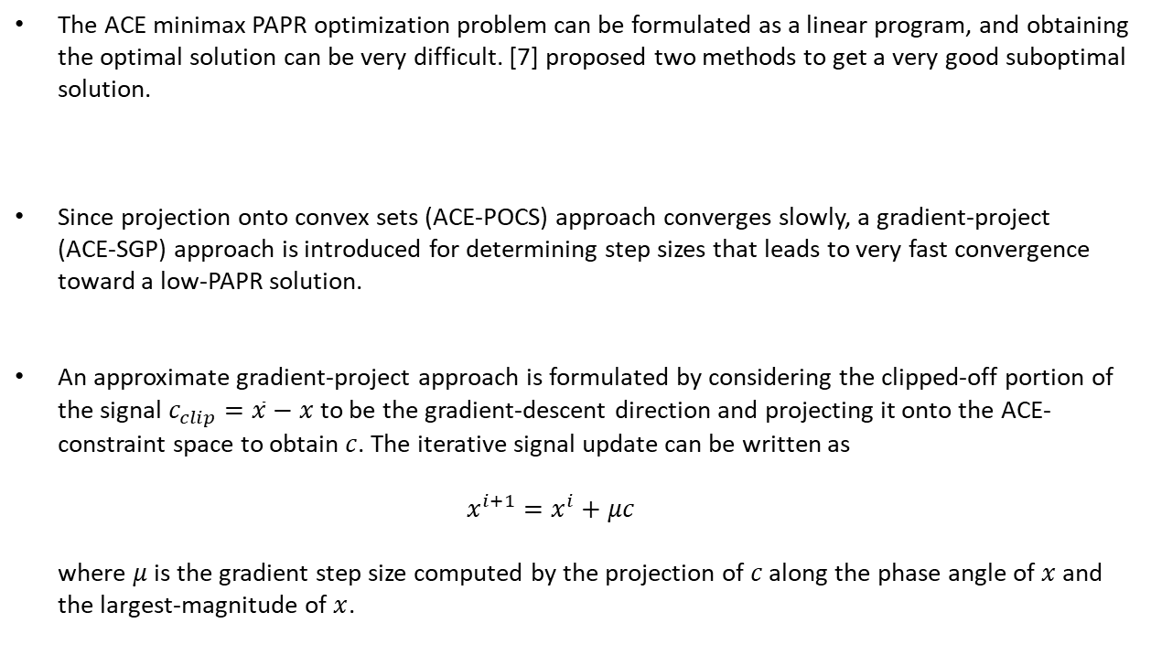
Practical ACE Implementation
The ACE minimax PAPR optimization problem can be formulated as a linear program, and obtaining the optimal solution can be very difficult. [7] proposed two methods to get a very good suboptimal solution.
Since projection onto convex sets (ACE-POCS) approach converges slowly, a gradient-project (ACE-SGP) approach is introduced for determining step sizes that leads to very fast convergence toward a low-PAPR solution.
An approximate gradient-project approach is formulated by considering the clipped-off portion of the signal $c_{clip}=\overline{x}−x$ to be the gradient-descent direction and projecting it onto the ACE-constraint space to obtain $c$. The iterative signal update can be written as $x^{i+1}=x^{i}+μc$ where $μ$ is the gradient step size computed by the projection of $c$ along the phase angle of $x$ and the largest-magnitude of $x$.
[7] B. S. Krongold and D. L. Jones, "PAR reduction in OFDM via active constellation extension," in IEEE Transactions on Broadcasting, vol. 49, no. 3, pp. 258-268, Sept. 2003.

Slide 18
Coding
Coding can also be used to reduce the PAPR, the idea is illustrated in the following example.
This approach suffers from the need to perform an exhaustive search to find the best code and to store large lookup tables for encoding and decoding. Moreover, the main disadvantage of this method is the good performance of the PAPR reduction at the cost of coding rate loss.
Data block X | PAPR (dB) | Data block X | PAPR (dB)
[1,1,1,1] | 6.0 | [-1,1,1,1] | 2.3
[1,1,1,-1] | 2.3 | [-1,1,1,-1] | 3.7
[1,1,-1,1] | 2.3 | [-1,1,-1,1] | 6.0
[1,1,-1,-1] | 3.7 | [-1,1,-1,-1] | 2.3
[1,-1,1,1] | 2.3 | [-1,-1,1,1] | 3.7
[1,-1,1,-1] | 6.0 | [-1,-1,1,-1] | 2.3
[1,-1,-1,1] | 3.7 | [-1,-1,-1,1] | 2.3
[1,-1,-1,-1] | 2.3 | [-1,-1,-1,-1] | 6.0
[8] S. B. Slimane, “Reducing the peak-to-average power ratio of OFDM signals through precoding,” IEEE Trans. Veh. Technol., vol. 56, no. 2, pp. 686–695, March 2007.

Slide 19
The Proposed System Model
Q-section code
PAPR reduction
data
Q-ECC
encoder
QAM
modulation
IFFT
channel
recovered data
Q-ECC
decoder
de-
modulation
FFT

Slide 20


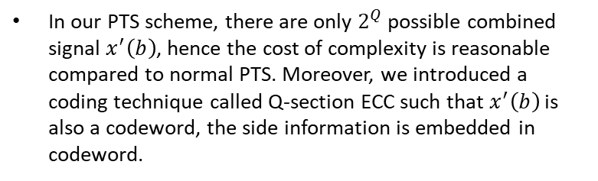

Q-section Coding with PTS Scheme
$$b=0,π$$
$$X_{1}$$
$$∙$$
$$b_{1}$$
Partition into blocks and serial to parallel conversion
Division into subblocks
IDFT
$$⊗$$
$$+$$
$$X_{2}$$
IDFT
$$∙$$
$$b_{2}$$
Data
Source
$$X$$
$$⊗$$
$$x^{′}(b)$$
$$⋮$$
$$⋮$$
$$X_{Q}$$
$$∙$$
$$b_{Q}$$
IDFT
$$⊗$$
Select one with minimum PAPR
In our PTS scheme, there are only $2^{Q}$ possible combined signal $x^{′}\left(b\right)$, hence the cost of complexity is reasonable compared to normal PTS. Moreover, we introduced a coding technique called Q-section ECC such that $x^{′}\left(b\right)$ is also a codeword, the side information is embedded in codeword.
Q-section control

Slide 21
Introduction of PAPR Issue
Some Reduction Techniques
System Model
Q-section Error Correcting Codes
Non-Coherent Block Coding (NBC)
Example of Polar-Coded Partial Transmit Sequence (PTS) Scheme for PAPR Reduction
Q-Section LDPC Codes Design
Encoding/Decoding Procedure
Protograph-Based LDPC
The Proposed Q-section PEG (Q-PEG)

Slide 22





Non-Coherent Block Coding
Assume that $C$ is a $(n,k)$ linear block code with generator matrix $G$ that contains an all-one row $g_{a}$.
With $g_{a}$, the data were protected from length-$n$ phase ambiguity, since both codeword $c$and phase-corrupted received vector $r$ correspond to the same data (vector $m$ without $m_{a}$).
By the Non-Coherent Block Coding (NBC) technique, the effect of error propagation in differential encoding can be avoided.
$$G=\left[\begin{matrix}g_{1} \\ g_{2} \\ ⋮ \\ g_{a} \\ ⋮ \\ g_{k}\end{matrix}\right]=\left[\begin{matrix} & & & \\ & ⋱ & & \\ & & ⋱ & \\ 1 & ⋯ & 1 & 1 \\ & ⋱ & & \\ & & ⋱ & \end{matrix}\right]$$
$$m=[m_{1},m_{2},⋯,m_{a},⋯,m_{k}]$$
channel with phase ambiguity
$$c=[c_{1},c_{2},⋯,c_{n}]$$
$$r=[r_{1},r_{2},⋯,r_{n}]$$
[9] Ruey-Yi Wei, "Noncoherent block-coded MPSK," in IEEE Transactions on Communications, vol. 53, no. 6, pp. 978-986, June 2005.

Slide 23

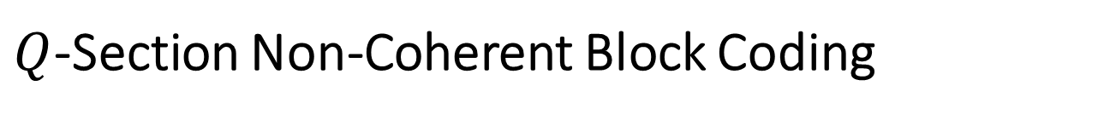



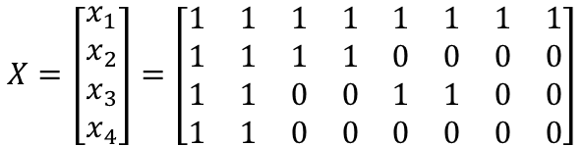

$Q$-Section Non-Coherent Block Coding
The codeword $c$ is splitted into Q-section if $G$ contains a vector set $X$, which has Q vectors each with section-wise all one property.
The $Q$-section NBC vector $X$ can be represented by $X={[x_{1},x_{2},⋯,x_{Q}] }^{T}$. For example, $n=8$ and $Q=4$ each section contains two bits.
The structure of Q-section NBC is very similar to the generator of Reed-Muller code.
$$X=\left[\begin{matrix}x_{1} \\ x_{2} \\ x_{3} \\ x_{4}\end{matrix}\right]=\left[\begin{matrix}1 & 1 & 1 & 1 & 1 & 1 & 1 & 1 \\ 1 & 1 & 1 & 1 & 0 & 0 & 0 & 0 \\ 1 & 1 & 0 & 0 & 1 & 1 & 0 & 0 \\ 1 & 1 & 0 & 0 & 0 & 0 & 0 & 0\end{matrix}\right]$$
$$S_{1}$$
$$S_{2}$$
$$S_{3}$$
$$S_{4}$$

Slide 24

Reed-Muller Code
A generator matrix for $RM(m,m)$ is defined as $G_{RM}\left(m,m\right)=F^{⊗m}, F=\left[\begin{matrix}1 & 0 \\ 1 & 1\end{matrix}\right]$ Then, for $0≤r≤m$, $G_{RM}\left(r,m\right)$ is taken as the submatrix of $G_{RM}\left(m,m\right)$ consisting of rows with Hamming weights $≥2^{m−r}$.
For example, $m=3$ $G_{RM}\left(3,3\right)=\left[\begin{matrix}1 & 0 & 0 & 0 & 0 & 0 & 0 & 0 \\ 1 & 1 & 0 & 0 & 0 & 0 & 0 & 0 \\ 1 & 0 & 1 & 0 & 0 & 0 & 0 & 0 \\ 1 & 1 & 1 & 1 & 0 & 0 & 0 & 0 \\ 1 & 0 & 0 & 0 & 1 & 0 & 0 & 0 \\ 1 & 1 & 0 & 0 & 1 & 1 & 0 & 0 \\ 1 & 0 & 1 & 0 & 1 & 0 & 1 & 0 \\ 1 & 1 & 1 & 1 & 1 & 1 & 1 & 1\end{matrix}\right]$ and
$$G_{RM}\left(1,3\right)=\left[\begin{matrix}1 & 1 & 1 & 1 & 0 & 0 & 0 & 0 \\ 1 & 1 & 0 & 0 & 1 & 1 & 0 & 0 \\ 1 & 0 & 1 & 0 & 1 & 0 & 1 & 0 \\ 1 & 1 & 1 & 1 & 1 & 1 & 1 & 1\end{matrix}\right]$$

Slide 25
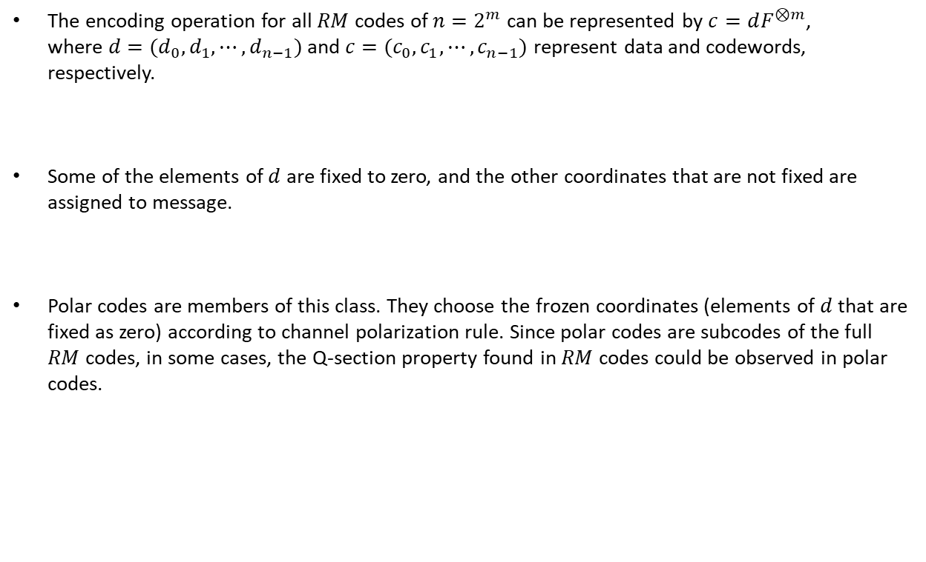
The encoding operation for all $RM$ codes of $n=2^{m}$ can be represented by $c=dF^{⊗m}$, where $d=(d_{0},d_{1},⋯,d_{n−1})$ and $c=(c_{0},c_{1},⋯,c_{n−1})$ represent data and codewords, respectively.
Some of the elements of $d$ are fixed to zero, and the other coordinates that are not fixed are assigned to message.
Polar codes are members of this class. They choose the frozen coordinates (elements of $d$ that are fixed as zero) according to channel polarization rule. Since polar codes are subcodes of the full $RM$ codes, in some cases, the Q-section property found in $RM$ codes could be observed in polar codes.
[10] E. Arikan, "A survey of reed-muller codes from polar coding perspective," 2010 IEEE Information Theory Workshop on Information Theory (ITW 2010, Cairo), Cairo, 2010.

Slide 26
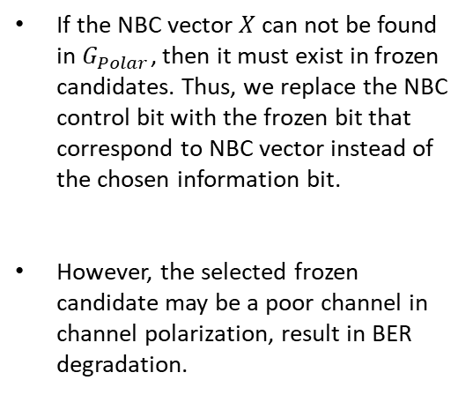
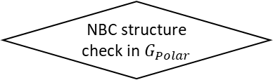
Input the design parameter (e.g., SNR, Bhattacharyya)
Polar code construction
yes
NBC structure check in $G_{Polar}$
no
If the NBC vector $X$ can not be found in $G_{Polar}$, then it must exist in frozen candidates. Thus, we replace the NBC control bit with the frozen bit that correspond to NBC vector instead of the chosen information bit.
However, the selected frozen candidate may be a poor channel in channel polarization, result in BER degradation.
NBC structure check in frozen bits
Replace the information bit that correspond to NBC vector as the NBC control bit
Replace the frozen bit that correspond to NBC vector as the NBC control bit
End

Slide 27
PAPR Control
The Q-section NBC might be a efficient technique in PAPR controlling, since it has very small BER degradation compared to the original code, and the data can be decoded without side information, this property is helpful for some PAPR reduction techniques, for example, multiple signaling method (PTS, SLM…).
16-QAM Constellation with Gray Mapping
$$∙$$
$$∙$$
$$(x_{2},x_{3})$$
$$∙$$
$$∙$$
0000
0100
1100
1000
In Gray mapping, every constellation point and their binary inverse must be located in opposite quadrants, i.e., the pair of real and imaginary value have different signs, this property may be helpful for our PAPR reduction design.
$$∙$$
$$∙$$
$$∙$$
$$∙$$
0001
0101
1101
1001
$$(x_{0},x_{1})$$
$$∙$$
$$∙$$
$$∙$$
$$∙$$
0011
0111
1111
1011
$$∙$$
$$∙$$
$$∙$$
$$∙$$
0010
0110
1110
1010

Slide 28
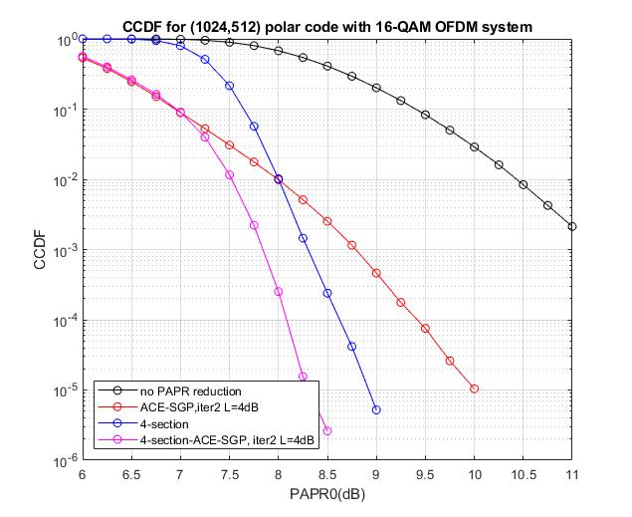

Slide 29
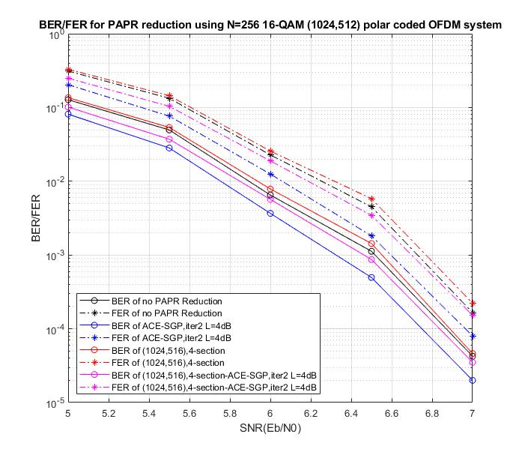

Slide 30
Introduction of PAPR Issue
Some Reduction Techniques
System Model
Q-section Error Correcting Codes
Non-Coherent Block Coding (NBC)
Example of Polar-Coded Partial Transmit Sequence (PTS) Scheme for PAPR Reduction
Q-Section LDPC Codes Design
Encoding/Decoding Procedure
Protograph-Based LDPC
The Proposed Q-section PEG (Q-PEG)

Slide 31

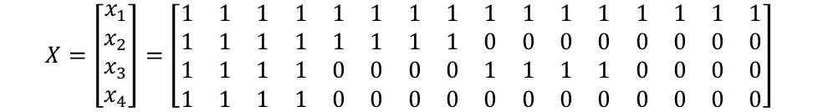
$$LDPC Code$$
Polar code naturally has the Q-section property in its generator matrix. But for LDPC codes, the codespace $C$is defined by the parity check matrix $H$. Hence some constraints should be added in the $H$, such that the NBC vectors are legal codewords in $C$.
Take 4-section NBC as example, we can observe that, every check node has even degree if $x_{1}$ is a legal codeword, every check node has even degree in one-half section if $x_{2}$ is a legal codeword, and so on.
Then $H$ is partitioned into Q-section, and all check nodes have even weight in each section, such that $H∙X^{T}=O$. We called this Q-section constraints.
$$X=\left[\begin{matrix}x_{1} \\ x_{2} \\ x_{3} \\ x_{4}\end{matrix}\right]=\left[\begin{matrix}1 & 1 & 1 & 1 & 1 & 1 & 1 & 1 & 1 & 1 & 1 & 1 & 1 & 1 & 1 & 1 \\ 1 & 1 & 1 & 1 & 1 & 1 & 1 & 1 & 0 & 0 & 0 & 0 & 0 & 0 & 0 & 0 \\ 1 & 1 & 1 & 1 & 0 & 0 & 0 & 0 & 1 & 1 & 1 & 1 & 0 & 0 & 0 & 0 \\ 1 & 1 & 1 & 1 & 0 & 0 & 0 & 0 & 0 & 0 & 0 & 0 & 0 & 0 & 0 & 0\end{matrix}\right]$$
$$H=\left[\begin{matrix}H_{1} & H_{2} & ⋯ & H_{Q}\end{matrix}\right]$$

Slide 32

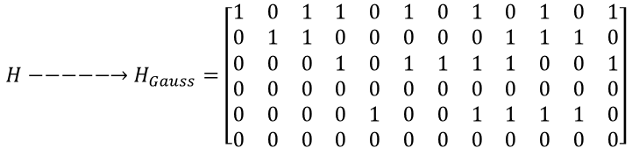
For LDPC encoding, the generator matrix $G$ can be found by performing Gauss elimination on $H$. In most cases, $H$ is not full rank, result in some all-zero rows after performing Gauss elimination. To obtain $G$ in the form of $G=[I|P]$, column exchange operation are needed. However, they are disallowed for Q-section property, since they might destruct the even weight property in column exchanged section.
We describe a simple solution in the following example, the null space of $H$ gives a $(12,8)$ LDPC code,
$$H−−−−−→H_{Gauss}=\left[\begin{matrix}1 & 0 & 1 & 1 & 0 & 1 & 0 & 1 & 0 & 1 & 0 & 1 \\ 0 & 1 & 1 & 0 & 0 & 0 & 0 & 0 & 1 & 1 & 1 & 0 \\ 0 & 0 & 0 & 1 & 0 & 1 & 1 & 1 & 1 & 0 & 0 & 1 \\ 0 & 0 & 0 & 0 & 0 & 0 & 0 & 0 & 0 & 0 & 0 & 0 \\ 0 & 0 & 0 & 0 & 1 & 0 & 0 & 1 & 1 & 1 & 1 & 0 \\ 0 & 0 & 0 & 0 & 0 & 0 & 0 & 0 & 0 & 0 & 0 & 0\end{matrix}\right]$$
Gauss elimination

Slide 33
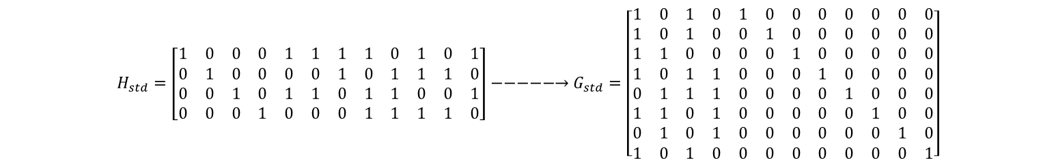

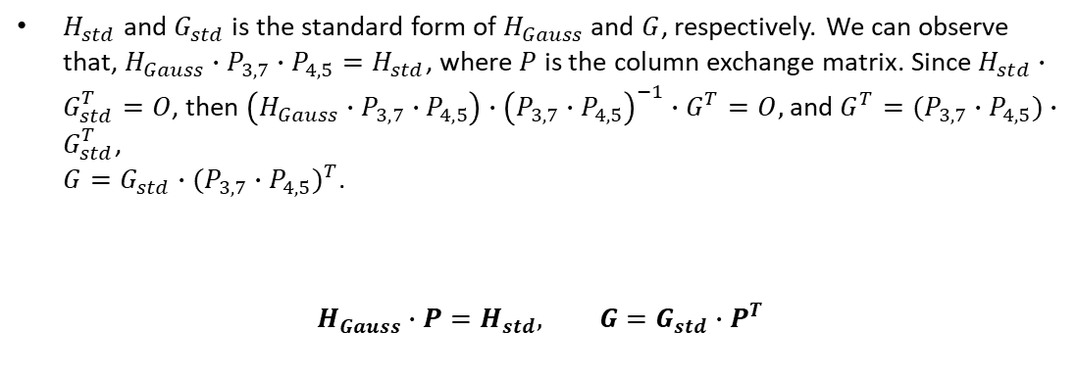
$$H_{std}=\left[\begin{matrix}1 & 0 & 0 & 0 & 1 & 1 & 1 & 1 & 0 & 1 & 0 & 1 \\ 0 & 1 & 0 & 0 & 0 & 0 & 1 & 0 & 1 & 1 & 1 & 0 \\ 0 & 0 & 1 & 0 & 1 & 1 & 0 & 1 & 1 & 0 & 0 & 1 \\ 0 & 0 & 0 & 1 & 0 & 0 & 0 & 1 & 1 & 1 & 1 & 0\end{matrix}\right]−−−−−→G_{std}=\left[\begin{matrix}1 & 0 & 1 & 0 & 1 & 0 & 0 & 0 & 0 & 0 & 0 & 0 \\ 1 & 0 & 1 & 0 & 0 & 1 & 0 & 0 & 0 & 0 & 0 & 0 \\ 1 & 1 & 0 & 0 & 0 & 0 & 1 & 0 & 0 & 0 & 0 & 0 \\ 1 & 0 & 1 & 1 & 0 & 0 & 0 & 1 & 0 & 0 & 0 & 0 \\ 0 & 1 & 1 & 1 & 0 & 0 & 0 & 0 & 1 & 0 & 0 & 0 \\ 1 & 1 & 0 & 1 & 0 & 0 & 0 & 0 & 0 & 1 & 0 & 0 \\ 0 & 1 & 0 & 1 & 0 & 0 & 0 & 0 & 0 & 0 & 1 & 0 \\ 1 & 0 & 1 & 0 & 0 & 0 & 0 & 0 & 0 & 0 & 0 & 1\end{matrix}\right]$$
$H_{std}$ and $G_{std}$ is the standard form of $H_{Gauss}$ and $G$, respectively. We can observe that, $H_{Gauss}∙P_{3,7}∙P_{4,5}=H_{std}$, where $P$ is the column exchange matrix. Since $H_{std}∙G_{std}^{T}=O$, then $\left(H_{Gauss}∙P_{3,7}∙P_{4,5}\right)∙{\left(P_{3,7}∙P_{4,5}\right)}^{−1}∙G^{T}=O,$ and $G^{T}=(P_{3,7}∙P_{4,5})∙G_{std}^{T}$, $G=G_{std}∙{(P_{3,7}∙P_{4,5})}^{T}$.
$$H_{Gauss}∙P=H_{std}, G=G_{std}∙P^{T}$$
$$(8)$$

Slide 34




Then we transform this designed parity check matrix $H$ into G, then add the four vectors [$x_{1}$, $x_{2}$, $x_{3}$, $x_{4}$] into G’s row.
However, the added Q-section vector $X$ in modified $G$ will interfere with the message in codeword $c$ if $G$is systematic and $v_{i}$ are non-zero in message part. Hence, we can only calculate the codebit error rate in receiver side.
To overcome this limitation, the NBC control bits should be considered as the messages but not for data transmission. Hence we need to find the linear combination of NBC vectors from the rows of $G$, and replace one element of them with the associated NBC vectors.
control bits
$$\left[\begin{matrix}G \\ x_{1} \\ x_{2} \\ x_{3} \\ x_{4}\end{matrix}\right]$$
$$∙$$
$$=c$$
$$m=[m_{0},m_{2},⋯,m_{k−1},m_{c1},m_{c2},m_{c3},m_{c4}]$$
Modified generator matrix

Slide 35
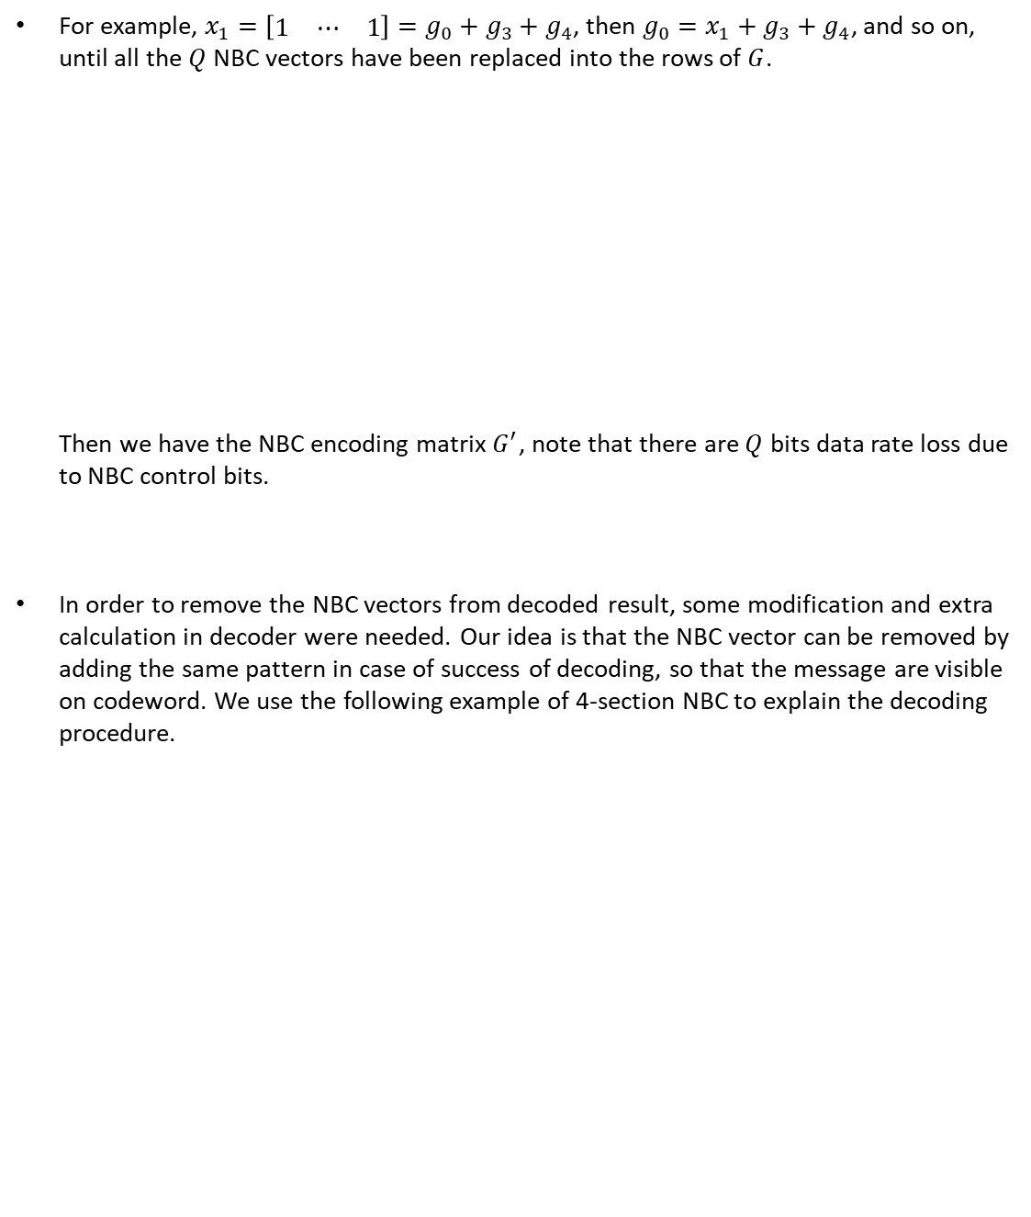



For example, $x_{1}=\left[\begin{matrix}1 & ⋯ & 1\end{matrix}\right]=g_{0}+g_{3}+g_{4}$, then $g_{0}=x_{1}+g_{3}+g_{4}$, and so on, until all the $Q$ NBC vectors have been replaced into the rows of $G$. Then we have the NBC encoding matrix $G^{′}$, note that there are $Q$ bits data rate loss due to NBC control bits.
In order to remove the NBC vectors from decoded result, some modification and extra calculation in decoder were needed. Our idea is that the NBC vector can be removed by adding the same pattern in case of success of decoding, so that the message are visible on codeword. We use the following example of 4-section NBC to explain the decoding procedure.
$$G^{′}=\left[\begin{matrix}x_{1} \\ ⋮ \\ x_{2} \\ ⋮ \\ x_{3} \\ ⋮ \\ x_{Q} \\ ⋮ \\ g_{k−1}\end{matrix}\right]$$
$$G=\left[\begin{matrix}g_{0} \\ g_{1} \\ g_{2} \\ g_{3} \\ g_{4} \\ ⋮ \\ g_{k−1}\end{matrix}\right]$$
replace one element from the linear combination of NBC vectors by $X$

Slide 36



Suppose $C$ is a $(512,256)$ NBC LDPC code with a $(256×512)$ $G^{′}$, $G^{′′}$ is the $G^{′}$ without NBC vectors, and $G^{′′}$ is $\left(252×512\right).$ We can apply the same idea from () to get the $H^{′′}$ corresponding to $G^{′′}$, where $H^{′′}$ is $\left(260×512\right)$.
Let $v$ be the decoded result from SPA decoder and $z$ be the modulo 2 summation of $v$ and $2^{Q}$ possible combination of NBC vectors. $z=v⊕a_{1}∙x_{1}⊕a_{2}∙x_{2}⋯⊕a_{Q}∙x_{Q}$ where $a_{i}=0,1,i=1,2,⋯,Q$. If $v$ is correct, then there must exist a $z$ such that $H^{′′}∙z^{T}=0$.
$$G^{′′}=\left[\begin{matrix}x_{1} \\ ⋮ \\ x_{2} \\ ⋮ \\ x_{3} \\ ⋮ \\ x_{4} \\ ⋮ \\ g_{255}\end{matrix}\right]$$
$$(9)$$

Slide 37
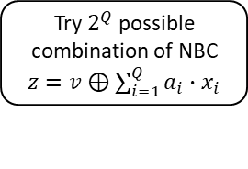


$$y=c+x+n$$
SPA decoding
$$v$$
Try $2^{Q}$ possible combination of NBC $z=v⊕\sum_{i=1}^{Q}{a_{i}∙x_{i}}$
$$z$$
Tentative Decoding by H””
fail
success
If $H^{′′}∙z^{T}=0$ or all pattern were tested
Termination
Output recovered message bits

Slide 38

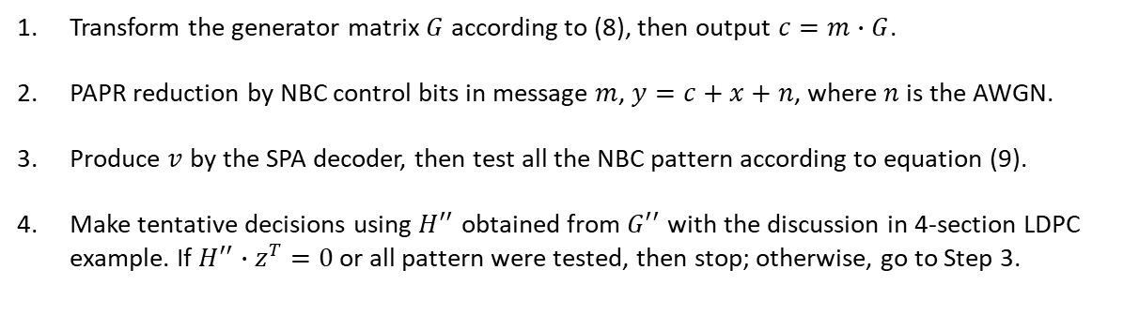
$Q$-Section LDPC Encoding/Decoding Procedure
Transform the generator matrix $G$ according to (8), then output $c=m∙G$.
PAPR reduction by NBC control bits in message $m$, $y=c+x+n$, where $n$ is the AWGN.
Produce $v$ by the SPA decoder, then test all the NBC pattern according to equation (9).
Make tentative decisions using $H^{′′}$ obtained from $G^{′′}$ with the discussion in 4-section LDPC example. If $H^{′′}∙z^{T}=0$ or all pattern were tested, then stop; otherwise, go to Step 3.
In the next part, we give an example of protograph-based LDPC code to illustrate the design of Q-section LDPC code, then we introduce our proposed modified PEG algorithm to construct the desired LDPC codes.

Slide 39


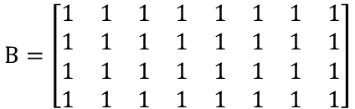

$$Protograph−Based LDPC$$
The Q-section property can be achieved by protograph-based LDPC codes. For example, with 4-section, each section contains 4 bits.
We can check that the four NBC vectors $v_{1}$, $v_{2}$, $v_{3}$ and $v_{4}$ all satisfy the parity check equations of $H$, i.e., they are legal codeword in this example.
$$H=\left[\begin{matrix}1 & 0 & 1 & 0 & 1 & 0 & 1 & 0 & 0 & 1 & 0 & 1 & 0 & 1 & 0 & 1 \\ 0 & 1 & 0 & 1 & 0 & 1 & 0 & 1 & 1 & 0 & 1 & 0 & 1 & 0 & 1 & 0 \\ 0 & 1 & 0 & 1 & 0 & 1 & 0 & 1 & 1 & 0 & 1 & 0 & 1 & 0 & 1 & 0 \\ 1 & 0 & 1 & 0 & 1 & 0 & 1 & 0 & 0 & 1 & 0 & 1 & 0 & 1 & 0 & 1 \\ 0 & 1 & 1 & 0 & 0 & 1 & 1 & 0 & 0 & 1 & 1 & 0 & 0 & 1 & 1 & 0 \\ 1 & 0 & 0 & 1 & 1 & 0 & 0 & 1 & 1 & 0 & 0 & 1 & 1 & 0 & 0 & 1 \\ 1 & 0 & 0 & 1 & 1 & 0 & 0 & 1 & 1 & 0 & 0 & 1 & 1 & 0 & 0 & 1 \\ 0 & 1 & 1 & 0 & 0 & 1 & 1 & 0 & 0 & 1 & 1 & 0 & 0 & 1 & 1 & 0\end{matrix}\right]$$
$$B=\left[\begin{matrix}1 & 1 & 1 & 1 & 1 & 1 & 1 & 1 \\ 1 & 1 & 1 & 1 & 1 & 1 & 1 & 1 \\ 1 & 1 & 1 & 1 & 1 & 1 & 1 & 1 \\ 1 & 1 & 1 & 1 & 1 & 1 & 1 & 1\end{matrix}\right]$$
lifting factor$=2$
4x8
8x16
[14] Y. Fang, G. Bi, Y. L. Guan and F. C. M. Lau, "A Survey on Protograph LDPC Codes and Their Applications," in IEEE Communications Surveys & Tutorials, vol. 17, no. 4, pp. 1989-2016, Fourthquarter 2015

Slide 40


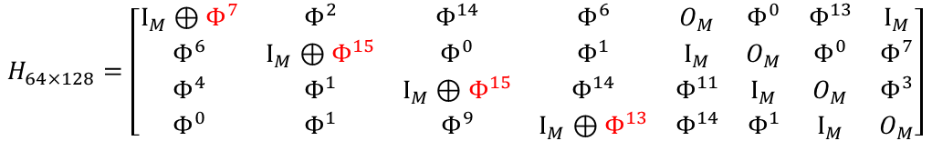
$$CCSDS LDPC Codes$$
The following example show specific modification of Q-section protograph-based LDPC codes.
$$M=16$$
$$H_{64×128}=\left[\begin{matrix}I_{M}⊕Φ^{7} & Φ^{2} & Φ^{14} & Φ^{6} & O_{M} & Φ^{0} & Φ^{13} & I_{M} \\ Φ^{6} & I_{M}⊕Φ^{15} & Φ^{0} & Φ^{1} & I_{M} & O_{M} & Φ^{0} & Φ^{7} \\ Φ^{4} & Φ^{1} & I_{M}⊕Φ^{15} & Φ^{14} & Φ^{11} & I_{M} & O_{M} & Φ^{3} \\ Φ^{0} & Φ^{1} & Φ^{9} & I_{M}⊕Φ^{13} & Φ^{14} & Φ^{1} & I_{M} & O_{M}\end{matrix}\right]$$
$$H_{64×128}^{′}=\left[\begin{matrix}I_{M} & Φ^{2} & Φ^{14} & Φ^{6} & Φ^{7} & Φ^{0} & Φ^{13} & I_{M} \\ Φ^{6} & I_{M} & Φ^{0} & Φ^{1} & I_{M} & Φ^{15} & Φ^{0} & Φ^{7} \\ Φ^{4} & Φ^{1} & I_{M} & Φ^{14} & Φ^{11} & I_{M} & Φ^{15} & Φ^{3} \\ Φ^{0} & Φ^{1} & Φ^{9} & I_{M} & Φ^{14} & Φ^{1} & I_{M} & Φ^{13}\end{matrix}\right]$$
[15] Short block length LDPC codes for TC synchronization and channel coding, Orange Book, Consultative Committee for Space Data Systems (CCSDS) Experimental Specification 231.1-O-1, Apr. 2015

Slide 41
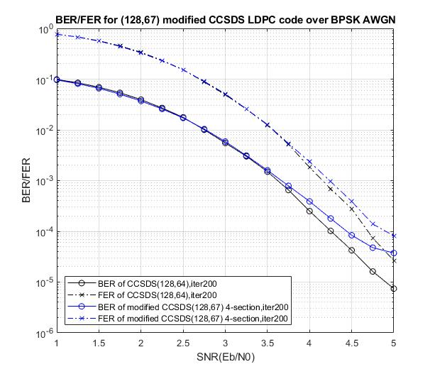
The null space of $H_{64×128}^{′}$ gives a $\left(128,67\right)$ LDPC code.

Slide 42
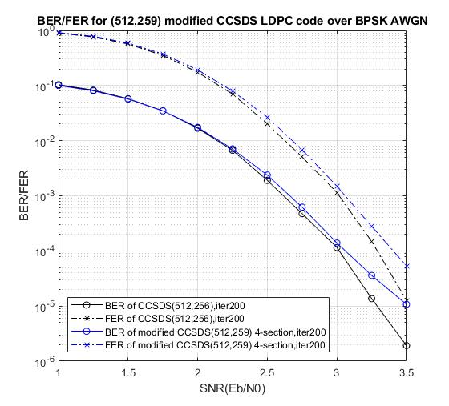
The null space of $H_{256×512}^{′}$ gives a $\left(512,259\right)$ LDPC code.

Slide 43
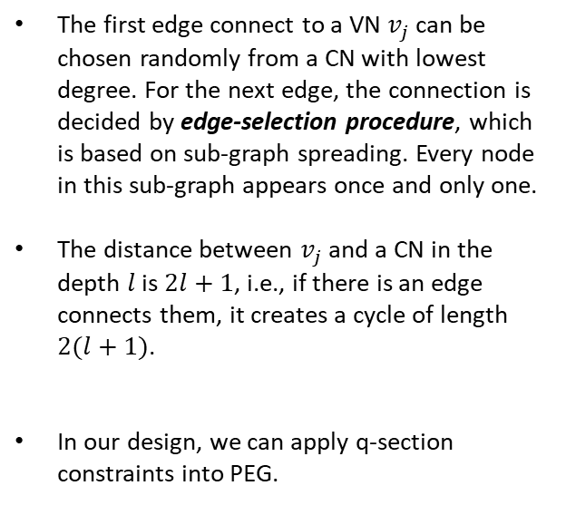






Progressive Edge Growth(PEG)
PEG is a graph-based method for constructing LDPC codes with large girth, begins with a bipartite graph of VNs and CNs without edges. Then edges are added one at a time to connect VNs and CNs (edge growth) by applying edge-selection procedure and a given VN degree profile.
$$v_{j}$$
depth 0
$$⋯$$
The first edge connect to a VN $v_{j}$ can be chosen randomly from a CN with lowest degree. For the next edge, the connection is decided by edge-selection procedure, which is based on sub-graph spreading. Every node in this sub-graph appears once and only one.
The distance between $v_{j}$ and a CN in the depth $l$ is $2l+1$, i.e., if there is an edge connects them, it creates a cycle of length $2(l+1)$.
In our design, we can apply q-section constraints into PEG.
depth 1
$$⋯$$
$$⋮$$
depth $l$
$$⋯$$
[16] Xiao-Yu Hu, E. Eleftheriou and D. M. Arnold, "Regular and irregular progressive edge-growth tanner graphs," in IEEE Transactions on Information Theory, vol. 51, no. 1, pp. 386-398, Jan. 2005

Slide 44


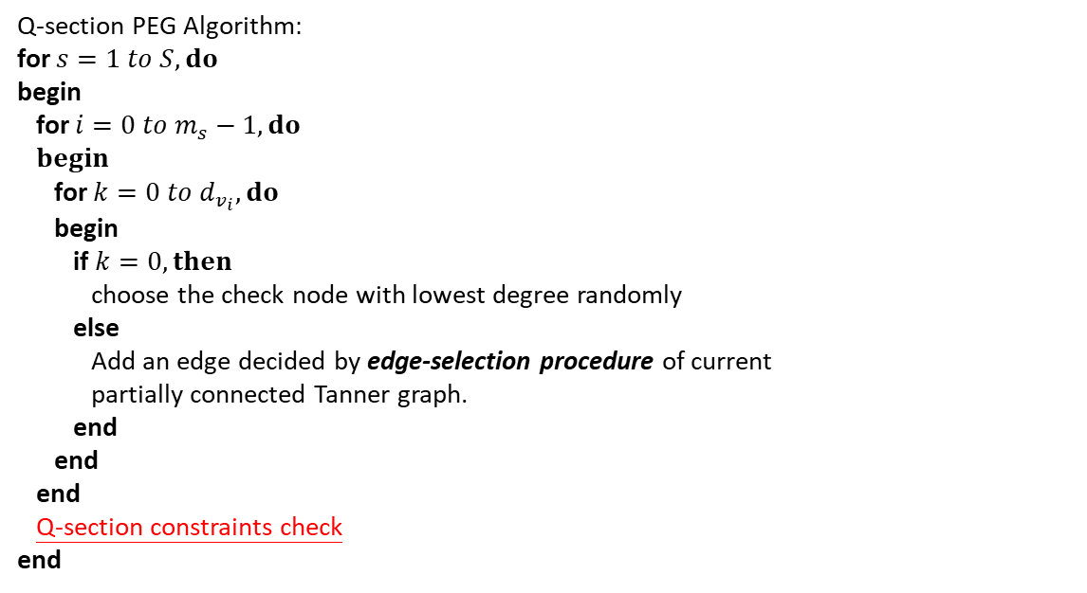


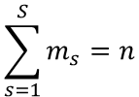









Q-Section PEG (Q-PEG)
Q-section PEG Algorithm$:$
for $s=1 to S, do$
begin
for $i=0 to m_{s}−1, do$
$begin$
for $k=0 to d_{v_{i}}, do$
begin
if $k=0, then$
choose the check node with lowest degree randomly
else
Add an edge decided by edge-selection procedure of current partially connected Tanner graph.
end
end
end
Q-section constraints check
end
$$\sum_{s=1}^{S}{m_{s}}=n$$
$$⋯$$
$$⋯$$
$$⋯$$
$$⋯$$
$$0$$
$$1$$
$$m_{1}−1$$
$$0$$
$$1$$
$$m_{2}−1$$
$$0$$
$$1$$
$$m_{S}−1$$
section 1
section 2
section $S$
Notes:
s is the index of section, S is the number of section,
每做完一段的variable node, 例如碼長為512,切成四段,一段有128個code bits,
Q-section PEG每做完128個bits, 會做Q-section constraints check檢查全部的check nodes在這一段是否滿足偶數個edge的限制

Slide 45
Q-section Constraint Check
section 1
section 2
section 3
section 4
Delete an edge from odd degree check nodes.
Notes:
目前只有做刪除的版本 但未來可能可以在這個部分優化
例如某個check node目前有三條edge 某個check node目前有一條edge
我們可以把三條edge的其中一條補給只有一條edge的check node
可以檢查哪種挑法不會造成short cycle(4or6)
如果都會造成short cycle再把奇數的edge刪掉一條

Slide 46
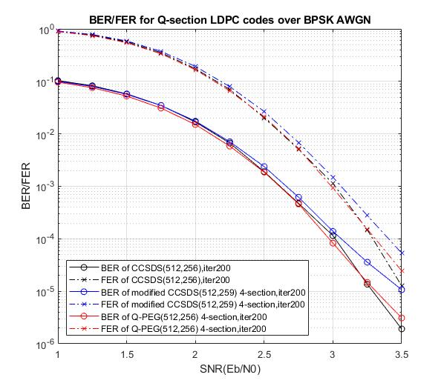
In the following example of Q-PEG, the regular-4 degree is adopted to avoid excessively deleting edges.
Notes:
BPSK AWGN的模擬結果
黑線是CCSDS沒有修改的LDPC code(未符合Q-section constraint)
藍線是經過簡單修改後的CCSDS LDPC code(code rate稍微提高到(512,259),且符合Q-section constraint)
紅線是用Q-section PEG做出來的(512,256) 我目前沒有做code search 這個是第一個跑出來的code
Q-section PEG再多試幾次應該能找到更好一點的code
紫線是GF(256)的LDPC code

Slide 47
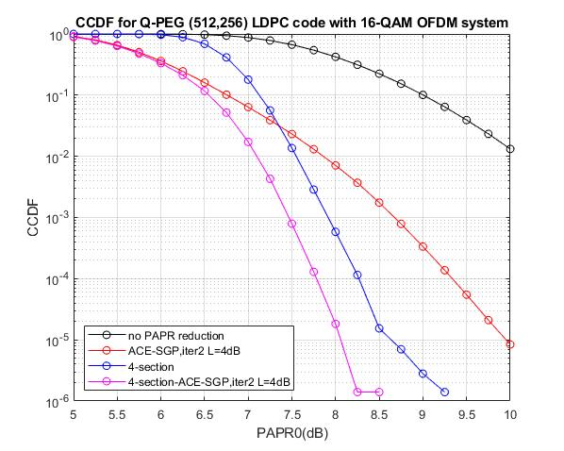

Slide 48
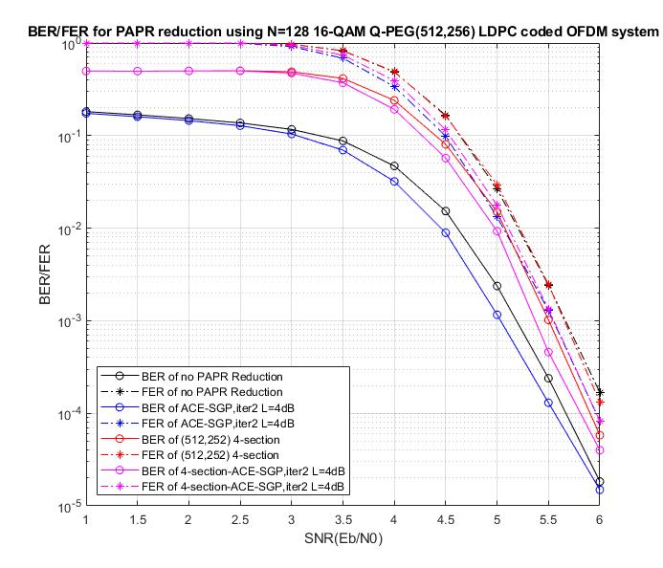
Notes:
黑線是message bit rate
藍線是code bit rate

Slide 49
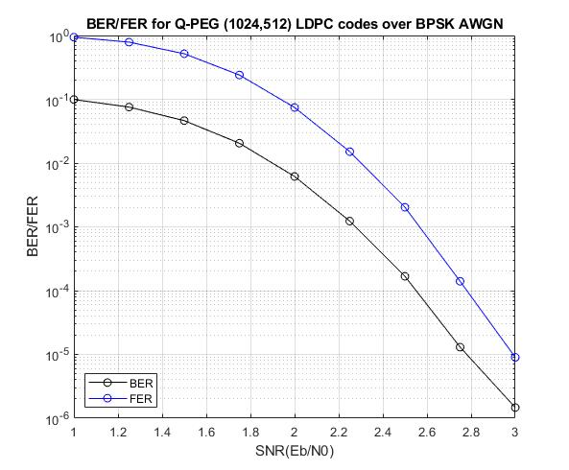

Slide 50
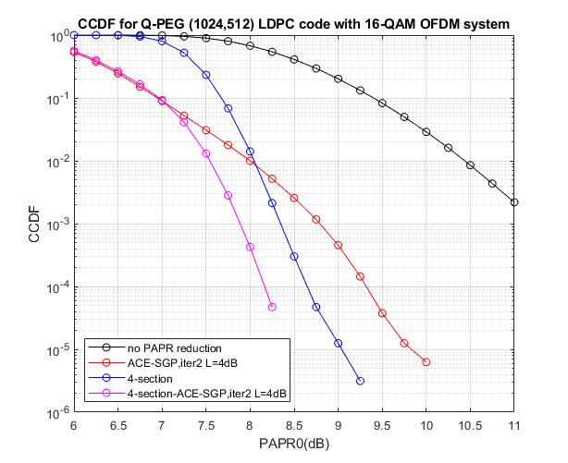

Slide 51

Notes:
黑線是message bit rate
藍線是code bit rate

Slide 52
Non-Binary LDPC Codes
Some Basics
Bit-Flipping Method for PAPR Reduction
Side Information Embedded Selective Mapping (SLM) for PAPR Reduction
Conclusions and Future Work

Slide 53
Non-binary LDPC codes
Binary LDPC codes can lead to very good performance for very long codeword length, but when accounting for practical constraints, it is not always satisfying.
Non-binary LDPC (NB LDPC) codes offer better resistance to errors and fit better the high spectral efficiency transmission [17]. Some results have proved their superiority under AWGN channel [18] and MIMO systems [19].
In these cases, NB LDPC codes have shown great potential, however the performance gain come with a significant increase of the decoding complexity.
[17] M. Arabaci and I. B. Djordjevic, "Binary and nonbinary LDPC-coded modulations for generalized fading channels," 2011 10th International Conference on Telecommunication in Modern Satellite Cable and Broadcasting Services (TELSIKS), Nis, 2011, pp. 148-151
[18] D. Declercq, M. Colas, and G. Gelle, “Regular GF(2q)-LDPC coded modulations for higher order QAM-AWGN channel,” in Proc. ISITA, Parma, Italy, Oct. 2004.
[19] X. Jiang, Y. Yan, X. gen Xia, and M. H. Lee, “Application of nonbinary LDPC codes based on euclidean geometries to MIMO systems,” in International Conference on Wireless Communications Signal Processing, 2009 (WCSP 2009), Nov. 2009, pp. 1–5.

Slide 54


Slide 55





QSPA/FFT-QSPA Algorithm
H $=\left[\begin{matrix}h_{0,0} & ⋯ & h_{0,n−1} \\ ⋮ & ⋱ & ⋮ \\ h_{m−1,0} & ⋯ & h_{m−1,n−1}\end{matrix}\right]$
H $={[h_{i,j}]}_{0≤i<m,0≤j<n}$ with $h_{i,j}∈$ GF($q$).
CNs
Edges carry pmfs
$$α$$
$$α^{2}$$
$$α^{4}$$
$$⋯⋯⋯$$
VNs
[20] M. C. Davey and D. J. C. MacKay, “Low density parity check codes over GF (q),” IEEE Commun. Lett., vol. 2, pp. 165–167, June 1998.
[21] D. J. C. MacKay and M. Davey, “Evaluation of Gallager codes for short block length and high rate applications,” in Proc. IMA Workshop Codes, Systems and Graphical Models, 1999
[22] J. Li, S. Lin, K. Abdel-Ghaffar, W. E. Ryan, and D. J. Costello, Jr., LDPC Code Designs, Constructions, and Unification, Cambridge, UK: Cambridge University Press, 2017.

Slide 56

All the following simulations are decoded of the FFT-QSPA.
[23] H. Wymeersch, H. Steendam and M. Moeneclaey, “Log-Domain Decoding of LDPC Codes over GF(q),” The Proc. IEEE Intern. Conf. on Commun., Paris, France, June 2004, pp. 772-776.
[24] Voicila, A., Declercq, D., Verdier, F., Fossorier, M. & Urard, P. Low-complexity decoding for non-binary LDPC codes in high order fields. IEEE Trans. Commun. 58, 1365–1375 (2010).
[25] V. Savin, “Min–Max decoding for non binary LDPC codes,” in Proc. IEEE Int. Symp. Inf. Theory, Toronto, ON, Canada, Jul. 2008, pp. 960.

Slide 57
Clipping-Based Bit-Flipping (CBBF)
The clipping-based bit-flipping (CBBF) method employs the concept of iterative clipping and distortion control to obtain deliberative bit flipping, where the control of distortion for the Euclidean distance for each signal point in the constellation in [7] is replaced by the control of total number of flipped bits, i.e., the bit positions were determined to be flipped so as to maximize the PAPR reduction and minimize the distortion.
The CBBF method can be combined with the ACE which allows the frequency-domain signal points obtained after the clipping operation to be located in areas extended from the original constellation.
[28] Y.-C. Liu, C.-F. Chang, S.-K. Lee, and M.-C. Lin, “Deliberate bit flipping with error-correction for PAPR reduction,” IEEE Trans. Broadcast., vol. 63, no. 1, pp. 123–133, Mar. 2017.

Slide 58


Slide 59


Slide 60
Bit-Flipping on Non-Binary LDPC
The AWGN channel with hard error: a hard error is introduced by bit-flipping on the LDPC codes before transmitting over the BI-AWGN channel.
$$\{b_{i}\}$$
(NB) LDPC Encoder
Hard Error
BPSK Modulation
AWGN
Channel
(NB) LDPC Decoder
MAP Detector
$$\{{\hat{b}}_{i}\}$$

Slide 61
Cascaded BSC-AWGN channel
Since the flipping errors caused by bit-flipping can be viewed as BSC, then the channel model is actually a concatenation of a BSC followed by a AWGN channel (BSC-BAWGN channel).
This channel belongs to a family of binary-input, memoryless, symmetric-output channels, one that we call the {CBMSC($ρ,σ$)} family, where $ρ$ is the transition probability of BSC corresponding to the portion of flipped bits, and $σ$ is the standard deviation of AWGN.
$$BSC(ρ)$$
$$Y_{n}$$
$$⊕$$
$$Z_{n}$$
$$X_{n}$$
$$N_{n}\sim 𝒩(0,σ^{2})$$
[26] A. Iyengar, P. Siegel, and J. Wolf, “Ldpc codes for the cascaded bscbawgn channel,” in 47th Annual Allerton Conference on Communication, Control, and Computing, 2009, pp. 620–627.

Slide 62


Slide 63
Modification of Channel LLR
$$BSC(ρ)$$
$$Y_{n}$$
$$⊕$$
$$Z_{n}$$
$$X_{n}$$
$$N_{n}\sim 𝒩(0,σ^{2})$$
$$p\left(z_{n} | x_{n}=1\right)=p\left(z_{n} | y_{n}=1\right)∙p\left(y_{n}=1 | x_{n}=1\right) \\ +p\left(z_{n} | y_{n}=−1\right)∙p\left(y_{n}=−1 | x_{n}=1\right) \\ =\left(1−ρ\right)∙\frac{1}{\sqrt{2πσ^{2}}}e^{\frac{−{\left(z_{n}−1\right)}^{2}}{2σ^{2}}}+ρ∙\frac{1}{\sqrt{2πσ^{2}}}e^{\frac{−{\left(z_{n}+1\right)}^{2}}{2σ^{2}}}$$
where the equality is the result of Markov characteristics of the channel, i.e., given $Y_{n}$, $X_{n}$ is independent of $Z_{n}$.
Then the LLR of the channel output for binary LDPC decoding is given by
$$L\left(x_{n} | z_{n}\right)=\ln{(\frac{\left(1−ρ\right)e^{\frac{−2z_{n}}{σ^{2}}}+ρ}{\left(1−ρ\right)+ρe^{\frac{−2z_{n}}{σ^{2}}}})}$$

Slide 64
In the case of binary LDPC, we have the LLR to be
In the case of NB-LDPC, the bit-level posteriori probability $p\left(x | y\right)=\frac{1}{1+exp⁡(−4yb/N_{0})}$ is replaced by $p\left(x=0 | z\right)=\frac{p(z|x=0) }{p(z|x=0) \text{+}p(z|x=1) }$ $=\frac{\left(1−ρ\right)e^{\frac{−{\left(z_{n}+1\right)}^{2}}{2σ^{2}}}+ρe^{\frac{−{\left(z_{n}−1\right)}^{2}}{2σ^{2}}}}{e^{\frac{−{\left(z_{n}+1\right)}^{2}}{2σ^{2}}}+e^{\frac{−{\left(z_{n}−1\right)}^{2}}{2σ^{2}}}}$ and $p\left(x=1 | z\right)=1−p\left(x=0 | z\right)$.
$$L\left(x_{n} | z_{n}\right)=\ln{(\frac{\left(1−ρ\right)e^{\frac{−2z_{n}}{σ^{2}}}+ρ}{\left(1−ρ\right)+ρe^{\frac{−2z_{n}}{σ^{2}}}})}$$

Slide 65


Slide 66





Side Information Embedded SLM
As the initial experiment, we chose the first four bits of $m_{1}$ as the control bits,
$b_{1},b_{2},b_{3},b_{4}$ introduce a hard error in $g_{1}$ to do PAPR reduction.
$$GF\left(q\right), q=2^{p}$$
$$[b_{1},b_{2},b_{3},b_{4},⋯,b_{p}]$$
$$G=\left[\begin{matrix}g_{1} \\ g_{2} \\ ⋮ \\ g_{k}\end{matrix}\right]$$
$$m=[m_{1},m_{2},⋯,m_{k}]$$
[29] A. M. El-Helw, E. F. Badran and H. Y. Al-Kafrawy, "A new sequence for embedding side information in SLM for PAPR reduction in OFDM," 2012 Japan-Egypt Conference on Electronics, Communications and Computers, Alexandria, 2012, pp. 53-56

Slide 67


Slide 68


Slide 69
Non-Binary LDPC Codes
Some Basics
Bit-Flipping Method for PAPR Reduction
Side Information Embedded Selective Mapping (SLM) for PAPR Reduction
Conclusions and Future Work

Slide 70
Conclusions and Future Work
In this thesis, we proposed the PAPR reduction schemes via partial transmit sequence and non-coherent block coding which are implemented by polar codes and LDPC codes. Besides, we further proposed a modified PEG algorithm to construct the desired LDPC codes with Q-section property. The Q-section PTS scheme can be combined with ACE to obtain more PAPR reduction. The analysis show that our proposed scheme can obtain good PAPR performance.
However, there is BER degradation in LDPC coded system, since the added NBC pattern will interfere with the messages which are embedded in codeword. Hence, some modifications on normal systematic encoding and decoding are set for removing NBC pattern. But the BER degradation on low SNR region is a challenging problem. We may design codes with very good BLER to avoid error propagation in second-stage tentative decision for removing NBC and use another idea to find a more appropriate de-mapping method.
Except the Q-section codes, we integrate non-binary LDPC codes into other previous work includes: bit-flipping method and side information embedded selective mapping method, the previous one shows a non-ideal trade off between PAPR and BER performance due to error propagation between non-binary symbols, the channel output LLR is modified according to combined channel assumption but still not accurate enough to compensate the flipping errors. The last one shows good result on PAPR and BER performance, however, non-binary LDPC coded modulation is still a unresolved and interesting problem, which may be a good candidate to get further improvement.

